Slide 1
Abstraction :-Abstraction is a process of hiding the implementation details and showing only functionality to the user.
Another way, it shows only essential things to the user and hides the internal details, for example, sending SMS where you type the text and send the message. You don't know the internal processing about the message delivery.
Abstraction lets you focus on what the object does instead of how it does it.
Ways to achieve Abstraction
There are two ways to achieve abstraction in java
Abstract class (0 to 100%)
Interface (100%)

Slide 2
Abstract class in Java
A class which is declared as abstract is known as an abstract class. It can have abstract and non-abstract methods. It needs to be extended and its method implemented. It cannot be instantiated.
Points to Remember
An abstract class must be declared with an abstract keyword.
It can have abstract and non-abstract methods.
It cannot be instantiated.
It can have constructors and static methods also.
It can have final methods which will force the subclass not to change the body of the method.

Slide 3
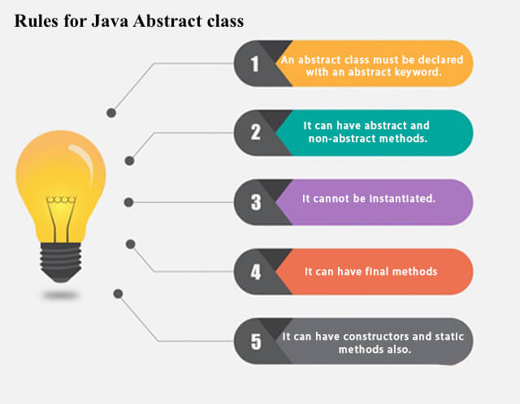

Slide 4
Example of abstract class
abstract class A{}
Abstract Method in Java
A method which is declared as abstract and does not have implementation is known as an abstract method.
Example of abstract method
abstract void printStatus();//no method body and abstract

Slide 5
Example of Abstract class that has an abstract method
In this example, Bike is an abstract class that contains only one abstract method run. Its implementation is provided by the Honda class.
abstract class Bike{
abstract void run();
}
class Honda4 extends Bike{
void run(){
System.out.println("running safely");}
public static void main(String args[]){
Bike obj = new Honda4();
obj.run();
}
}

Slide 6
Understanding the real scenario of Abstract class
In this example, Shape is the abstract class, and its implementation is provided by the Rectangle and Circle classes.
Mostly, we don't know about the implementation class (which is hidden to the end user), and an object of the implementation class is provided by the factory method.
A factory method is a method that returns the instance of the class. We will learn about the factory method later.
In this example, if you create the instance of Rectangle class, draw() method of Rectangle class will be invoked.

Slide 7
abstract class Shape{
abstract void draw();
}
//In real scenario, implementation is provided by others i.e. unknown by end user
class Rectangle extends Shape{
void draw(){System.out.println("drawing rectangle");}
}
class Circle1 extends Shape{
void draw(){System.out.println("drawing circle");} output- drawing circle
}
//In real scenario, method is called by programmer or user
class TestAbstraction1{
public static void main(String args[]){
Shape s=new Circle1();//In a real scenario, object is provided through method, e.g., getShape() method
s.draw();
}
}

Slide 8
Another example of Abstract class in java
abstract class Bank{
abstract int getRateOfInterest(); output - Rate of Interest is: 7 % Rate of Interest is: 8 %
}
class SBI extends Bank{
int getRateOfInterest(){return 7;}
}
class PNB extends Bank{
int getRateOfInterest(){return 8;} }
class TestBank{
public static void main(String args[]){
Bank b;
b=new SBI();
System.out.println("Rate of Interest is: "+b.getRateOfInterest()+" %");
b=new PNB();
System.out.println("Rate of Interest is: "+b.getRateOfInterest()+" %");
}}

Slide 9
Abstract class having constructor, data member and methods
An abstract class can have a data member, abstract method, method body (non-abstract method), constructor, and even main() method.
abstract class Bike{
Bike(){System.out.println("bike is created");}
abstract void run();
void changeGear(){System.out.println("gear changed");}
}
//Creating a Child class which inherits Abstract class
class Honda extends Bike{
void run(){System.out.println("running safely..");}
} //Creating a Test class which calls abstract and non-abstract methods
class TestAbstraction2{
public static void main(String args[]){
Bike obj = new Honda(); output -bike is created
obj.run();
obj.changeGear(); running safely..
}
} ` gear changed

Slide 10
Rule: If there is an abstract method in a class, that class must be abstract.
class Bike12{
abstract void run();
}
Output – compile time error

